Slide 1


SIMATS ENGINEERING
SAVEETHA INSTITUTE OF MEDICAL AND TECHNICAL SCIENCES
CAPSTONE PROJECT PRESENTATION
CSA1707 - ARTIFICIAL INTELLIGENCE
AI-Powered Electrical Panel Fault Prediction and Preventive Maintenance System
Guided By : Dr. R. Veeramani
Presented By :
V.Lasya(192524186)
V.G.Abbiramy(192524097)
S.Divyasri(192524388)

Slide 2
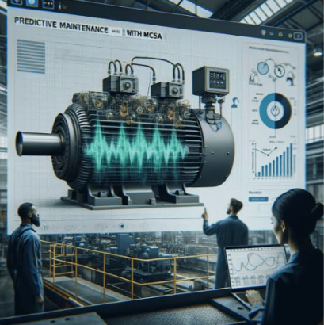
ABSTRACT
The system monitors the temperature and current of an electrical panel continuously using sensors.
An ESP32 collects and processes the real-time sensor data.
It identifies overheating and abnormal current conditions that may indicate potential faults.
The system analyzes abnormal patterns to provide early fault prediction and warning.
The proposed solution supports predictive maintenance, improved safety, and Industry 4.0 applications
3

Slide 3
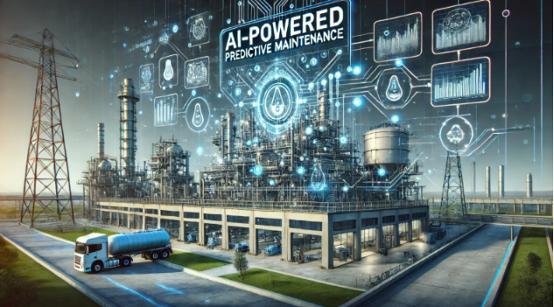
INTRODUCTION
Electrical panels are essential for safe and reliable power distribution in industries, buildings and commercial facilities.
Common problems include overheating, overload, abnormal voltage/current, loose connections and component degradation.
Traditional maintenance is mainly scheduled or reactive and may not identify developing faults early.
Artificial Intelligence can learn patterns from sensor data and predict abnormal conditions before a major failure.
2

Slide 4
PROBLEM STATEMENT
Electrical panel faults such as overheating and abnormal current can cause equipment damage and unexpected failures.
Traditional inspection methods may not detect these problems before they become critical.
Continuous manual monitoring is time-consuming and inefficient for industrial environments.
There is a need for a low-cost real-time system that can monitor electrical conditions continuously.
The proposed system aims to detect abnormal conditions early and predict potential faults using ESP32 and sensor-based monitoring.
4

Slide 5
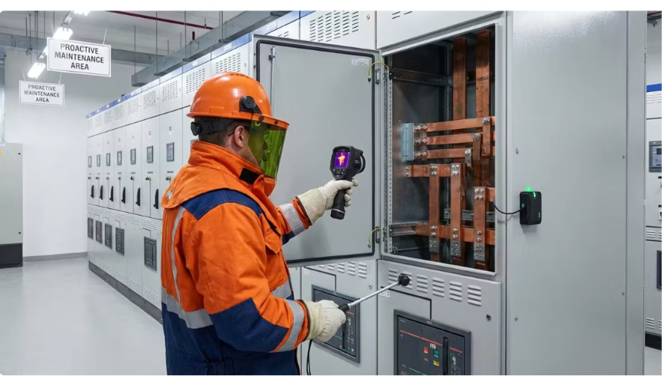
OBJECTIVES
To continuously monitor temperature and current in an electrical panel using sensors.
To use ESP32 for real-time collection and processing of sensor data.
To detect overheating and abnormal current conditions at an early stage.
To analyze sensor readings to identify and predict potential electrical faults.
To improve safety, reliability, and predictive maintenance in Industry 4.0 environments.
5

Slide 6
LITERATURE REVIEW
Year | Research / Study | Method / Focus | Key Finding | Limitation
2022 | Machine Learning for Predictive Maintenance | ML-based condition monitoring | ML can identify abnormal equipment behavior | Requires sufficient quality data
2023 | AI-Based Fault Diagnosis in Electrical Systems | Machine learning & fault classification | AI improves early detection of electrical faults | Model accuracy depends on sensor data
2024 | IoT-Based Predictive Maintenance | IoT sensors + real-time monitoring | Continuous monitoring enables early fault identification | Connectivity and hardware cost
2024 | Deep Learning for Equipment Fault Prediction | Deep learning & time-series analysis | Learns complex patterns from historical sensor data | Requires larger datasets and computation
2025 | AI-Driven Predictive Maintenance Review | AI/ML + condition monitoring | Predictive maintenance can reduce failures and improve maintenance planning | Real-world implementation remains challenging
10

Slide 7
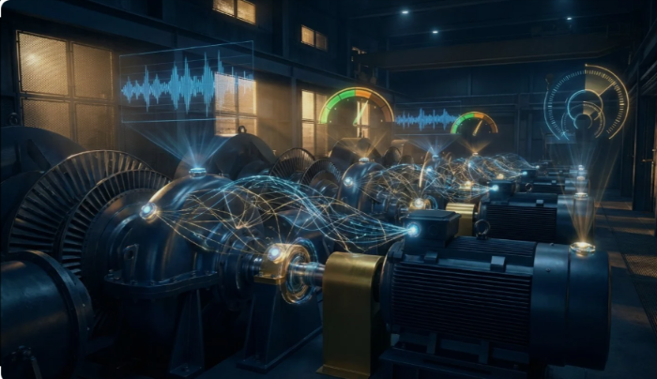
EXISTING SYSTEM
Electrical panels are mainly monitored through manual inspection and scheduled maintenance.
Faults such as overheating, overload, and abnormal current may be detected only after noticeable symptoms occur.
Traditional systems generally use fixed maintenance schedules instead of predicting the actual condition of equipment.
Continuous manual monitoring is time-consuming and may miss developing faults.
These limitations can lead to unexpected failures, equipment damage, downtime, and higher maintenance costs.

Slide 8

PROPOSED SYSTEM
The proposed system uses an ESP32-based monitoring unit to continuously monitor electrical panel conditions.
A current sensor measures the electrical current, while a temperature sensor monitors the panel temperature.
The ESP32 collects and processes the sensor readings in real time.
The system analyzes the readings to identify normal, warning, and abnormal/fault conditions.
The system helps enable early fault detection, preventive maintenance, improved safety, and reduced downtime.
8

Slide 9
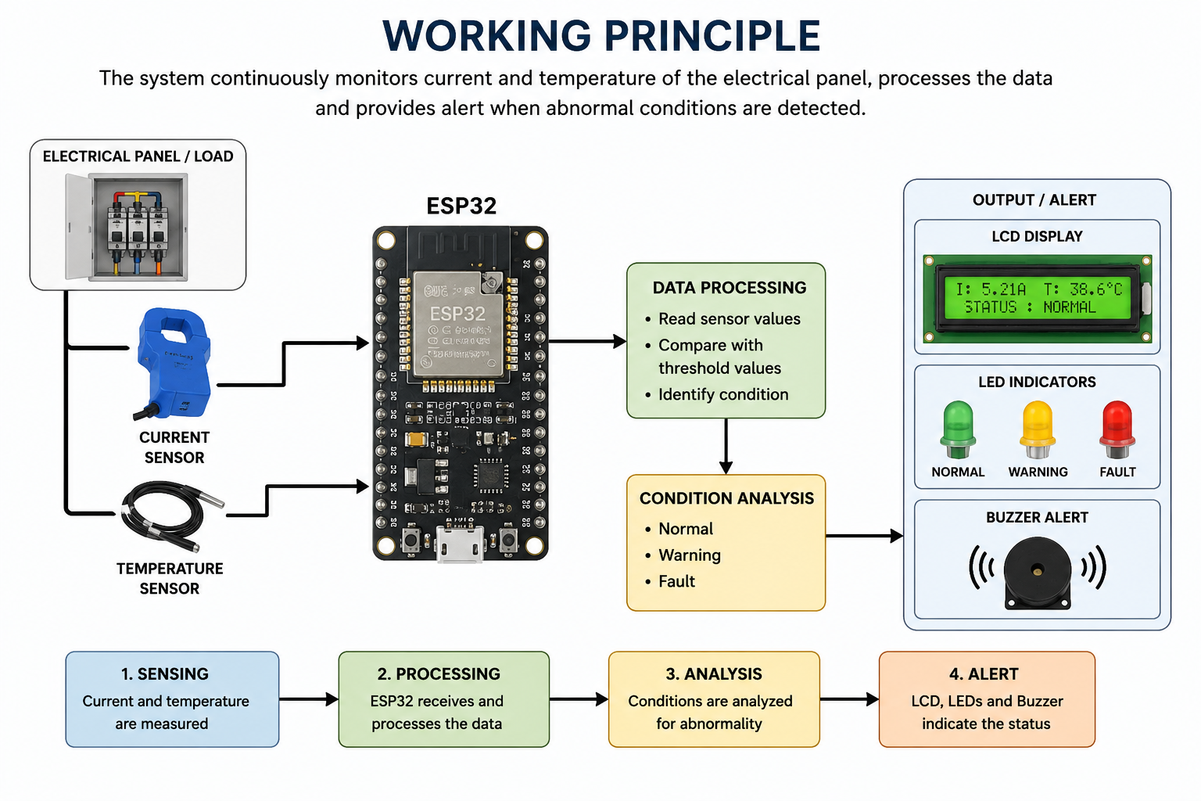
8

Slide 10
MODULE 1 :SENSING & DATA COLLECTION
Objective : To collect real-time electrical and thermal data from the electrical panel using sensors.
Content:
The current sensor measures the current flowing through the electrical load.
The temperature sensor continuously monitors the temperature of the electrical panel.
Both sensors provide real-time readings to the ESP32.
The ESP32 collects and processes the sensor data for further analysis.
The collected data acts as the primary input for detecting abnormal conditions and predicting potential faults.
14

Slide 11
MODULE 2: AI FAULT PREDICTION
Objective: To process the sensor readings and identify abnormal electrical and thermal conditions.
Content:
The ESP32 receives the current and temperature readings from the sensors.
The sensor values are processed and continuously monitored in real time.
The system compares the readings with the defined normal operating conditions.
Abnormal changes in current or temperature are identified as potential fault conditions.
The system classifies the panel condition as Normal, Warning, or Fault.
The processed data supports early prediction of possible electrical failures.
15

Slide 12
MODULE 3: PREVENTIVE MAINTENANCE
Objective: To display the system condition and provide an alert when an abnormal condition or potential fault is detected.
Content:
The processed sensor values and system status are displayed on the LCD.
LED indicators provide a visual indication of the panel condition.
A buzzer provides an audible alert when a fault condition is detected.
The system indicates different conditions such as Normal, Warning, and Fault.
Early alerts help the user take preventive action before a major electrical failure occurs.
16

Slide 13
DATASET
Dataset: Real-time sensor data collected from the electrical panel.
Parameters: The dataset contains current (A), temperature (°C), timestamp, and fault condition.
Data Collection: An ESP32 collects current and temperature readings continuously.
Algorithm Used: Threshold-based rule classification is used to identify Normal, Warning, and Fault conditions.
Future AI/ML: An AI/ML model can be integrated later using historical sensor data for more accurate fault prediction.

Slide 14
METHODOLOGY
Sensor Data Collection – The current and temperature sensors continuously collect real-time data from the electrical panel.
ESP32 Data Acquisition – The ESP32 receives the sensor readings and processes the collected data.
Data Analysis – The current and temperature values are monitored to identify abnormal operating conditions.
Fault Prediction – Abnormal patterns such as excessive current or overheating are identified as potential fault conditions.
Alert & Indication – The system displays the status on the LCD and provides LED/buzzer alerts when a warning or fault is detected.
17

Slide 15
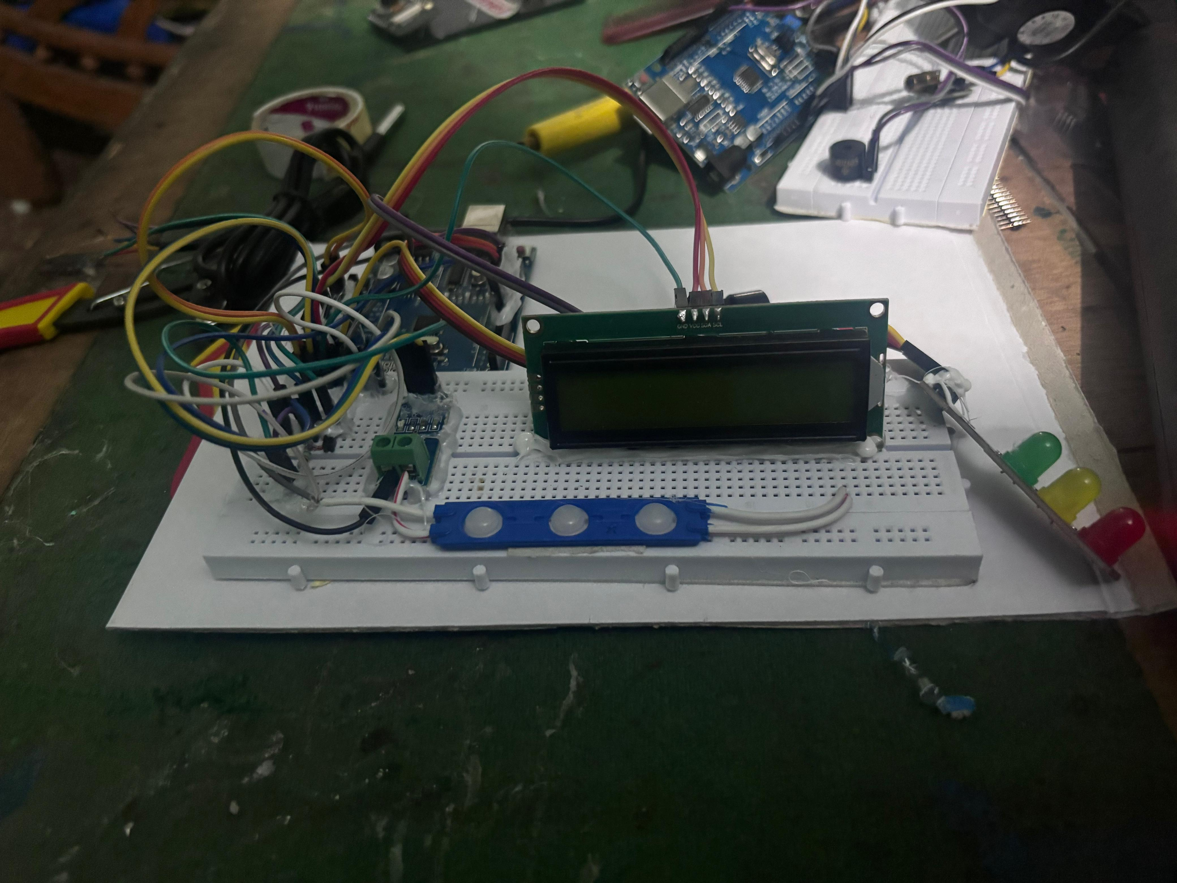
IMPLEMENTATION

Slide 16
RESULTS & DISCUSSION
Real-Time Monitoring
Continuous monitoring of current and temperature
Condition Detection
Identifies normal and abnormal electrical conditions
Fault Alerting
LED, LCD and buzzer indicate warning or fault status
Preventive Action
Early alerts help prevent equipment damage and unexpected failure
19

Slide 17
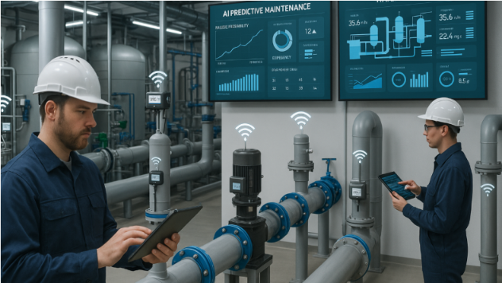
FUTURE SCOPE
Integrate an AI/ML model for more accurate fault prediction.
Add Wi-Fi and cloud connectivity for remote monitoring.
Develop a web/mobile dashboard with real-time notifications.
Store sensor data for historical analysis and fault trends.
Expand monitoring to include voltage, power, vibration, and multiple electrical panels.
20

Slide 18
CONCLUSION
The proposed system successfully provides real-time monitoring of electrical panel current and temperature.
The ESP32 effectively collects and processes sensor readings to identify abnormal conditions.
The system detects conditions such as overheating and abnormal current at an early stage.
LCD, LEDs, and buzzer alerts provide clear indication of the panel status.
The system supports predictive maintenance, improved safety, and reduced risk of unexpected electrical failures in Industry 4.0 environments.
20

Slide 19
REFERENCES
Jardine, A. K. S., Lin, D., & Banjevic, D. (2025). A review on machinery diagnostics and prognostics implementing condition-based maintenance. Mechanical Systems and Signal Processing.
ISO 17359:2018. Condition monitoring and diagnostics of machines – General guidelines. International Organization for Standardization.
NFPA 70B (2023). Standard for Electrical Equipment Maintenance. National Fire Protection Association.
Lei, Y., Li, N., Guo, L., Li, N., Yan, T., & Lin, J. (2022). Intelligent fault diagnosis of machinery using machine learning and deep learning approaches. Mechanical Systems and Signal Processing.
Carvalho, T. P., Soares, F. A. A. M. N., Vita, R., Francisco, R. P., Basto, J. P., & Alcalá, S. G. S. (2022). A systematic literature review of machine learning methods applied to predictive maintenance. Computers & Industrial Engineering.
21

Slide 20
THANK YOU
22

